Slide 1
Smart Bird-Feeder

Slide 2
Agenda
Introduction
Problem Statement
Sketches
Demo
Questions

Slide 3
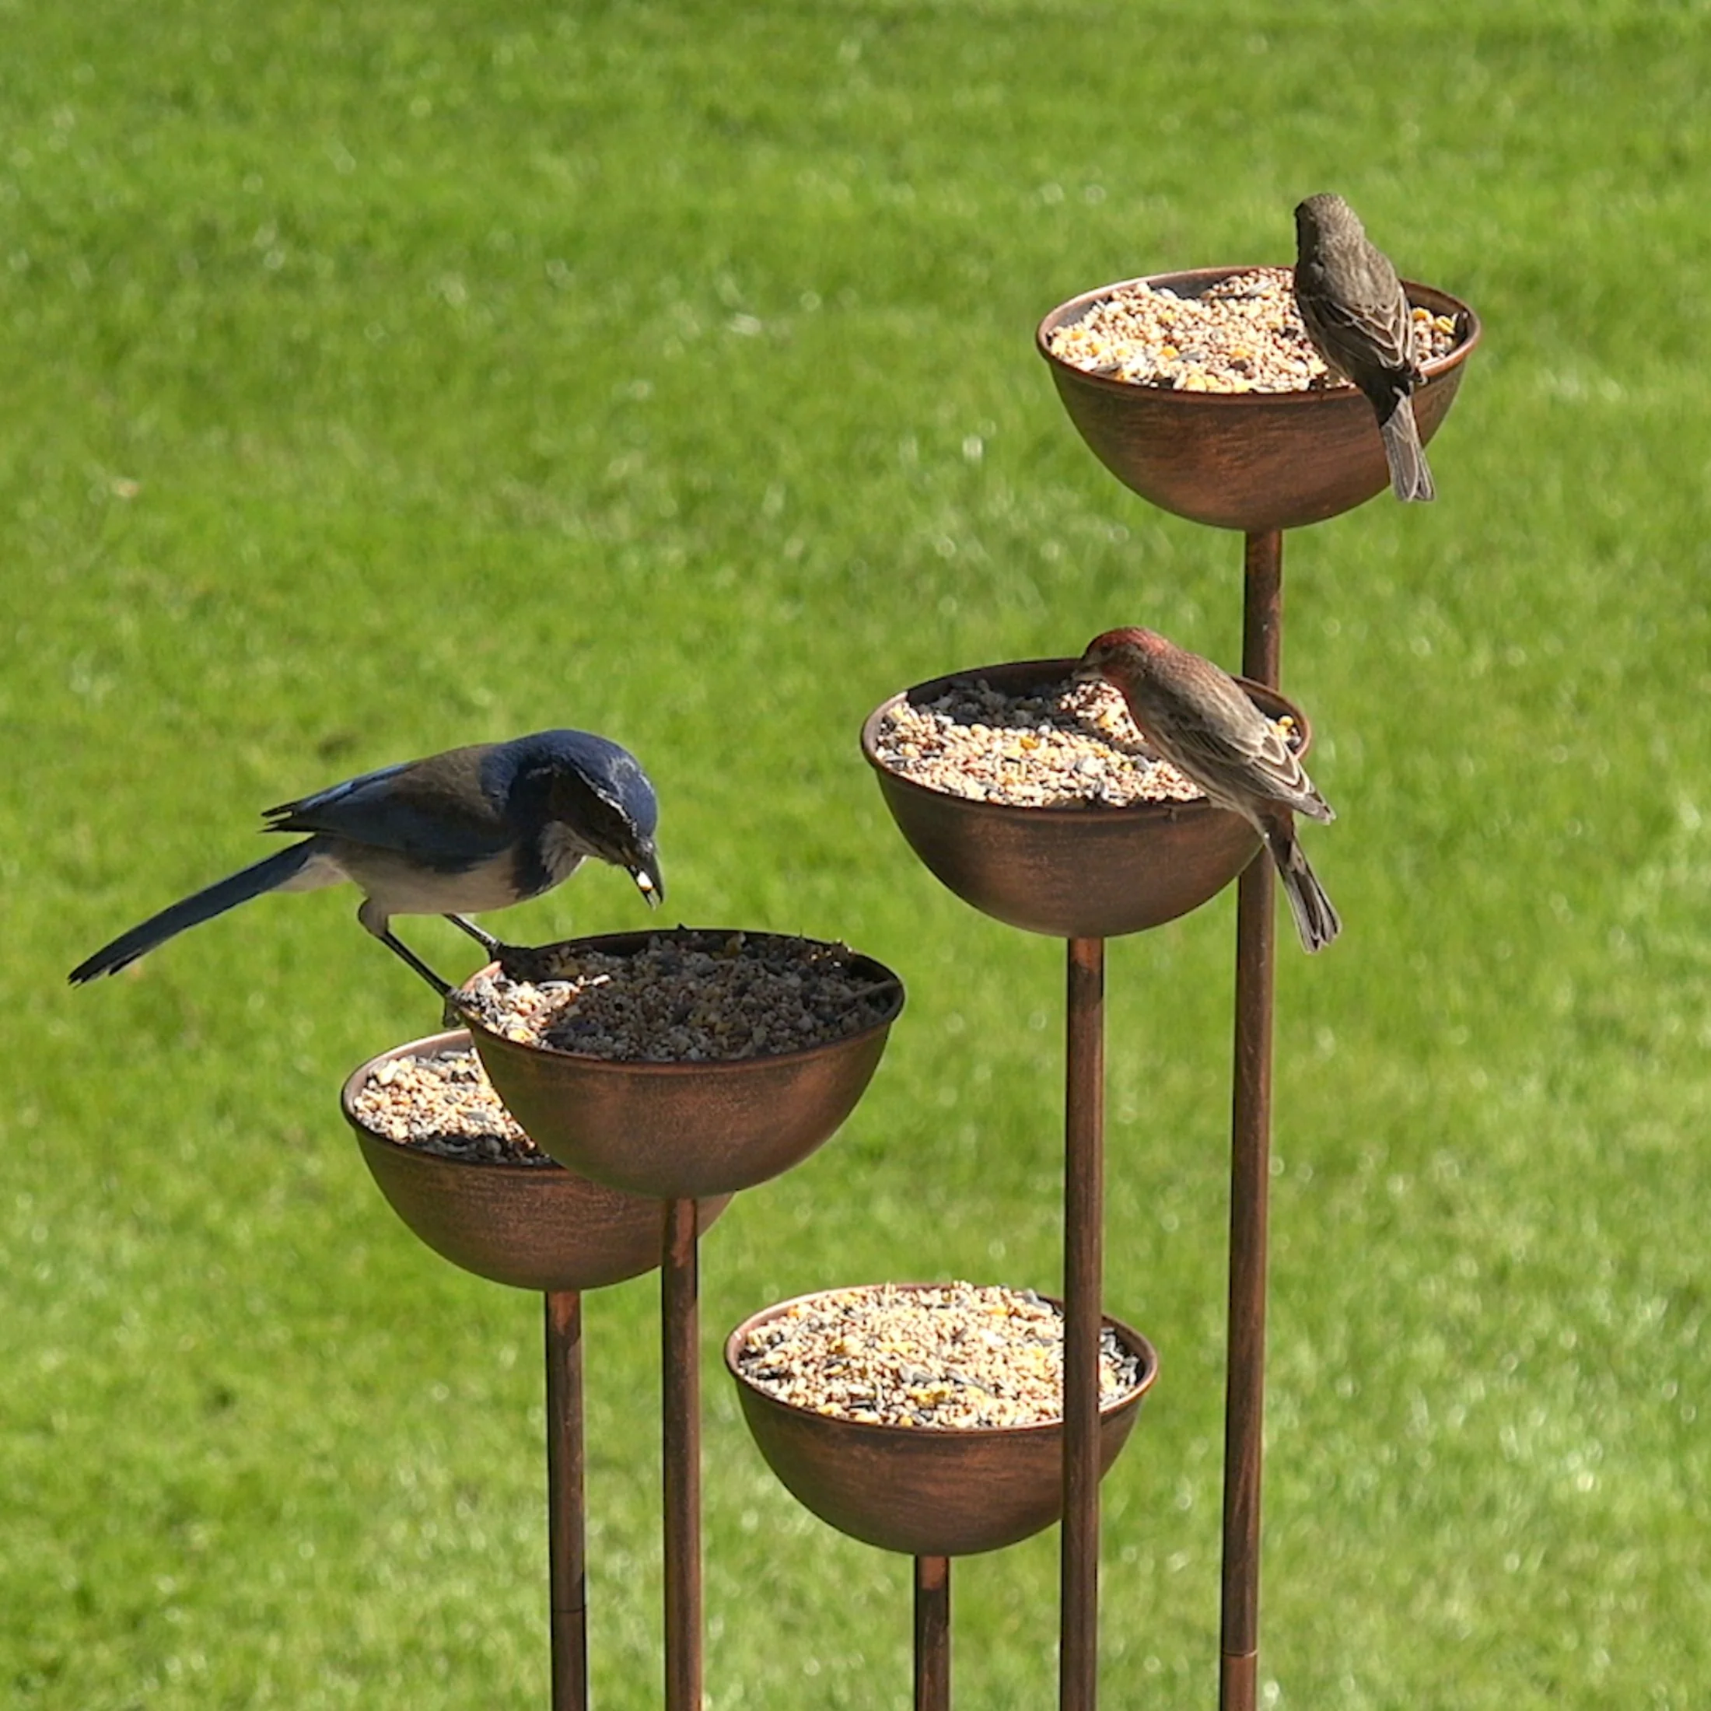
Issues with Bird Feeders
You can’t see the birds if you aren’t there.
Needing to keep track of food.
Easy to mistake species of birds with each other.

Slide 4
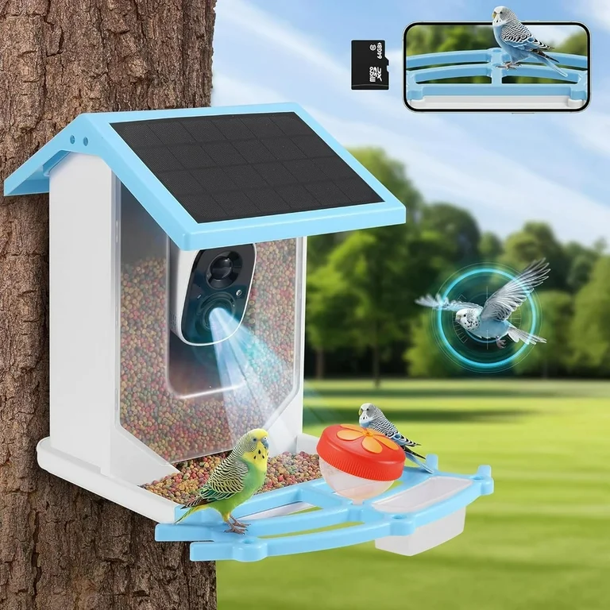
What do we do to solve this
Designing a bird feeder with cameras and sensors
Creating an app to track bird visits and inform about feeder status
Simplify and sets reminders for maintenance upkeeps
Not actual design, for presentation purposes only

Slide 5
Demo

Slide 6
Questions?
Zachary Brown
Grant Guernsey
Bartosz Kawalkowski

